Slide 1

Vehicular Pollution monitoring using IoT

Slide 2
Team : Group #10
Members:
Akshat Mathur
Muhammed Rihaj K S
Prasun Karmakar
SMD RAFFI

Slide 3
Abstract
The environmental problems are growing rapidly. Transportation can be responsible for more than 50% of carbon monoxide in the environment which is a major cause of health issues in urban places. The objective of this proposed project is to monitor air pollution on the roads and track vehicle that causes pollution more than a specified limit. The proposed project will also report the status of air quality whenever needed to the agencies . The measured data is also shared to the vehicle owner , traffic department and other various agencies.

Slide 4
Project Objectives
To monitor and detect polluted vehicle with its range of pollution which helps to control pollution and reduce global warming by using IoT.
Real time monitoring

Slide 5
Project deliverables
Track the vehicle's GPS location in the form of latitude and longitude. After that using a gas sensor , sense the pollution ranges of the Vehicle. This pollution ranges compared with standard reference level. If the pollution level is higher than standard value, then send mail/SMS/or alert via a Mobile app to RTO control station. If pollution level is normal, then continuously compare pollution with standard reference level until our pollution ranges changes.

Slide 6
Problems intended to be addressed by the project:
This project would provide us with an effective way of vehicular pollution management, addresses the cause of major pollution in the urban areas.
Currently , the pollution of the individual vehicles are tested at emission testing centres at periodic long intervals specified by the motor vehicle department and this wouldn’t provide a real time status of the vehicle's emission data. This project addresses this major concern.
Motor vehicle department catches and fines any illegal vehicle on the road during their random inspection on the road; a relatively non efficient way of enforcement of the law. This project addresses this issue where any vehicle on road with illegal emission can be easily tracked and booked.

Slide 7
Applicability/ usage and future potential of the outputs/Technologies of proposed project:
Detection of potential accidents
In case of high pollution, automatic switching off the engine remotely from the motor vehicle department.
Upcoming Ambulance and fire engine detection and alert the vehicles on the way.
This system can also be used for measuring air quality of any area so that authorities can take prompt action such as possible evacuation or sending emergency response team

Slide 8
International and National status
International:
In Glasgow, Scotland, the University of Strathclyde Institute for Future Cities and the industry-led Centre for Sensor and Imaging Systems (CENSIS) uses a sensor network on vehicles to monitor carbon monoxide (CO), particulate matter (PM), temperature, humidity, pressure, nitric oxide (NO), nitric dioxide (NO₂), ozone (O₃) and position.
National:
As per our knowledge, there is no used cases yet.

Slide 9
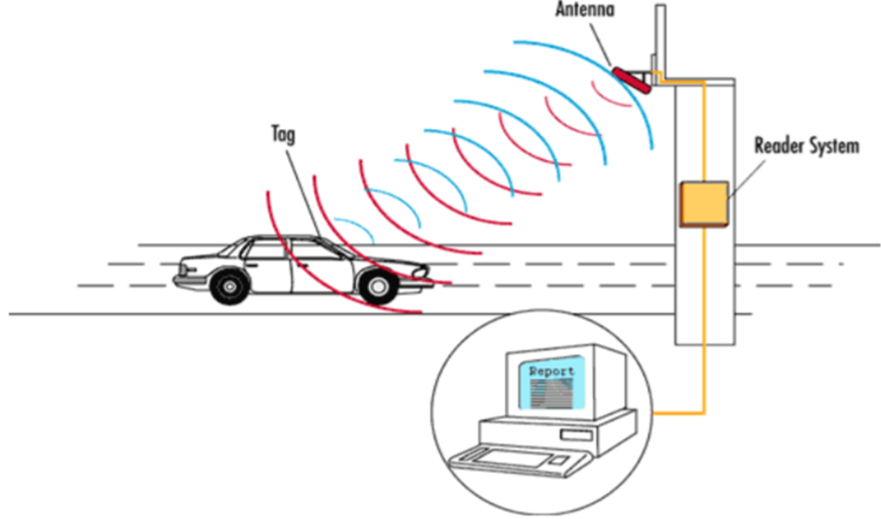
DESIGN OF THE PRPOSED SYSTEM
The framework of the proposed system uses IoT to address the vehicular pollution in real-time applications. Two gas sensors CO2, SOx are used to monitor the pollutants continuously to maintain the quality of the air.
The block diagram of the proposed air pollution monitoring system is shown in Fig
Proposed monitoring system using RFIDs

Slide 10
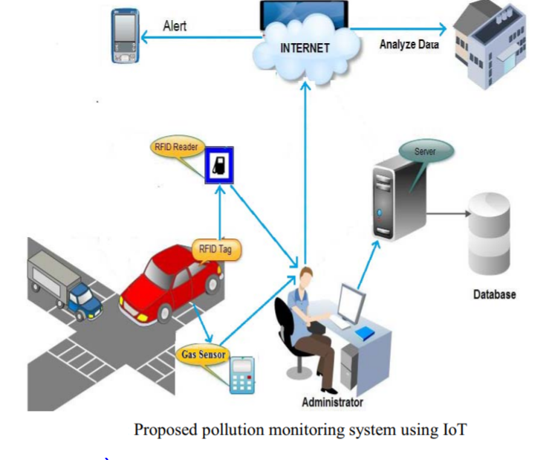
The real time monitoring of vehicular pollution system using IoT
At monitor location, the RFID reader, wireless gas sensors are integrated along with microcontroller. This entire system is placed in either of the road. Whenever the vehicles equipped with RFID tags passed through the sensor node, RFID reader presented in the monitoring system detects the vehicles and the sensors measures quality of the air produced by that vehicle. The sensed continuous data is sent to the microcontroller for verification of the pollution level of the vehicle. The microcontroller verifies the levels of the pollutants of the air produced by the vehicle. If the pollutants levels are beyond the threshold levels, then it sends the warning message to the vehicle owner. The same data is displayed on the Liquid Crystal Display (LCD). The information about the levels of CO2 and SOx, vehicular number, RFID of the vehicle and time and date of vehicle are also sent to the server of the authorized agencies. This information is stored in the server database for future analysis.

Slide 11
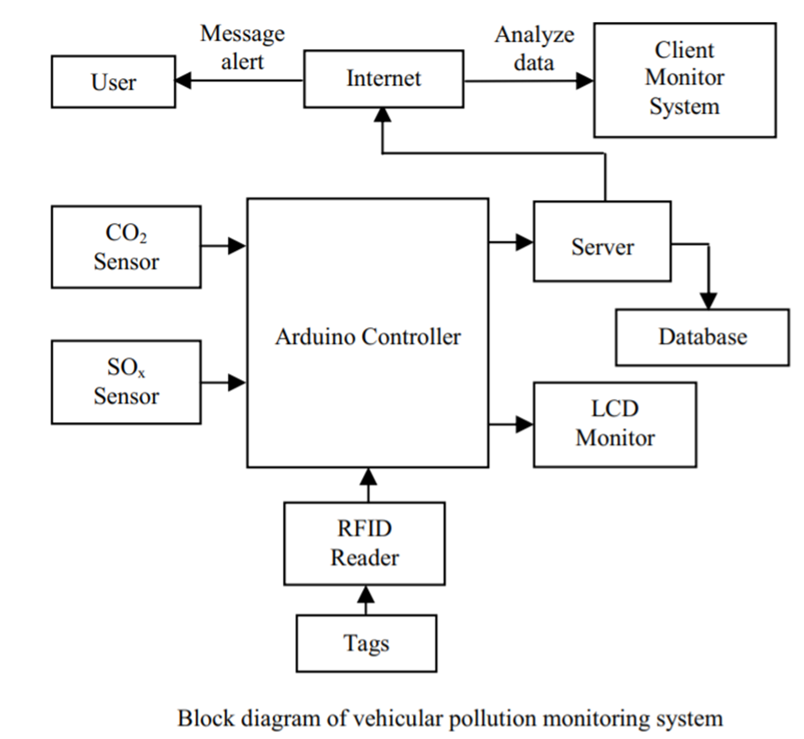
Block diagram of vehicular pollution monitoring system
The development of the proposed system is categorized into two parts: (i) hardware implementation and (ii) software implementation. a. Hardware implementation: The hardware of the proposed air pollution monitoring system mainly consists of arduino microcontroller development board, ATmega328 microcontroller, MQ Gas sensors, EM-18 RFID reader and RFID tag.

Slide 12
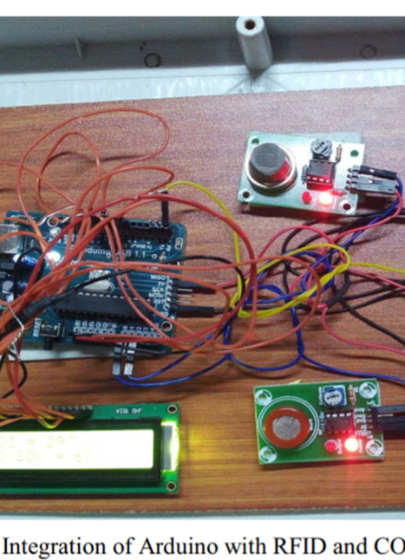
Hardware and software deployment
i. ATmega328 microcontroller: It is a low power and high-performance microcontroller used to read and control the data from sensors and RFID reader. It sends the data to server and LCD display for displaying the pollution level and RFID ID.
ii.Arduino board: Arduino is a hardware source platform that can work with different communication technologies and sensor devices. Due to its simplicity and number of hardware extensions more users and developers are used the Arduino.
iii. Wireless Gas Sensors: In this research work MQ-7, MQ-2 gas sensor is used to measure the carbon dioxide and sulpher oxides concentration in air. It is simple and low cost gas sensors. There are widely used because of they provide high performance and better accuracy.
iv. Radio Frequency Identification: RFID technology is used for detecting, tracking and finding location of vehicles. In this proposed system Em-18 RFID reader and RFID card is used. RFID card is inserted to vehicles, it has 12 byte data. RFID reader detects RFID card and it sends the data to microcontroller.
The information of RFID card sends serially to Arduino board through active RFID reader. The Arduino microcontroller board read the data and also sends the data to terminal and server using IoT

Slide 13
Hardware and software deployment
The server is developed using the java language. It uses Receiver Transmitter Communication (RxTxComm) library. This RxTxComm library is used for serial communication between server and client. The server performs four main functions. These are:
Receives and displays the data of the wireless sensors through microcontroller,
The first function of the server is a real time collection of data from sensors on the road when a vehicle passes through the node
Stores sensors data in the database for future analysis,
The second function is for storing the data of vehicles pollution levels using MySQL
Sends the sensors data to client to analyze the data, and
Sends warning messages to vehicle owners when the pollutants levels exceeds threshold level.
The Third & Fourth functions are for making the data available to all the users and control agencies through IoT.
The client page is implemented in java language. The page uses library of RxTxComm. The main function of client is to receive wireless sensors data from server using IoT. Client page analyses the data that contains pollution levels of vehicles in a specified area.

Slide 14

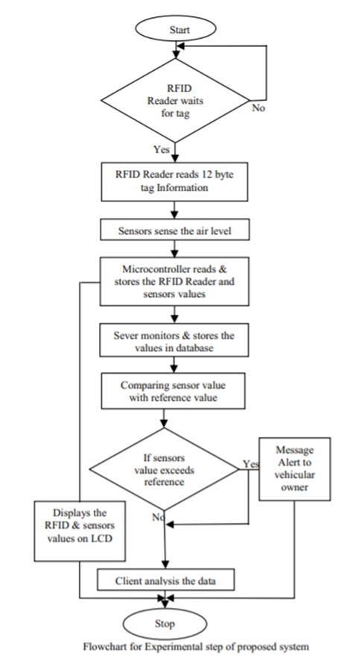



Flowchart of The software implementation of the proposed system

